Slide 1
THE PRESENTATION PROJECT of ELECTRICITY BILL CALCULATOR
SUBMITTED FROM:
Name : Akhi Moon Jahan
ID. : C223202
Semester : 1AF(Autumn 2022)
SUBMITTED TO:
MD. KHALILUZZAMAN
ASSISTANT PROFESSOR,
CSE, IIUC

Slide 2
Objective:
The Electricity Bill calculator project is an application based mini project, which is used to predict the electricity bill of following month by taking input of loads used. This application is to help people who do not have a technical understanding of calculating power bills can use this program to forecast their electricity bills for the coming months.
Requirement Analysis:
This programed code is written by Programiz-C Compiler & Codeblocks. Some recent Electricity Bill Copies of BPDB (Bangladesh Power Development Board) were analyzed thoroughly for getting the standard idea of all loads’ power rating, VAT and service charge.

Slide 3
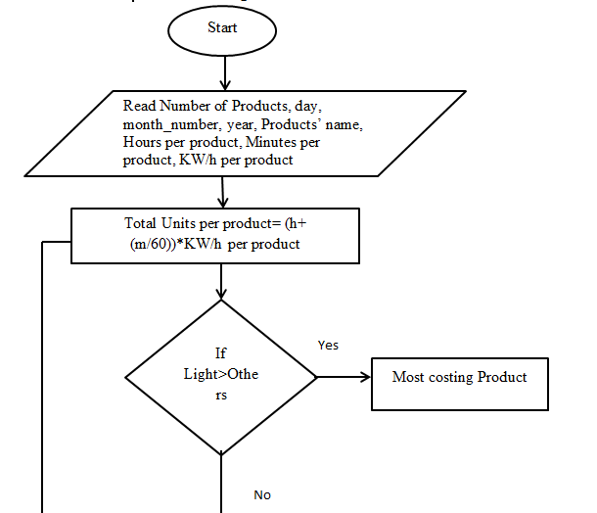
Design: To simplify the source code, the code is revised by designing a flow chart following---

Slide 4
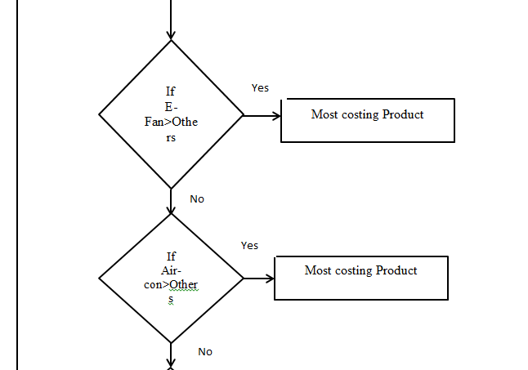
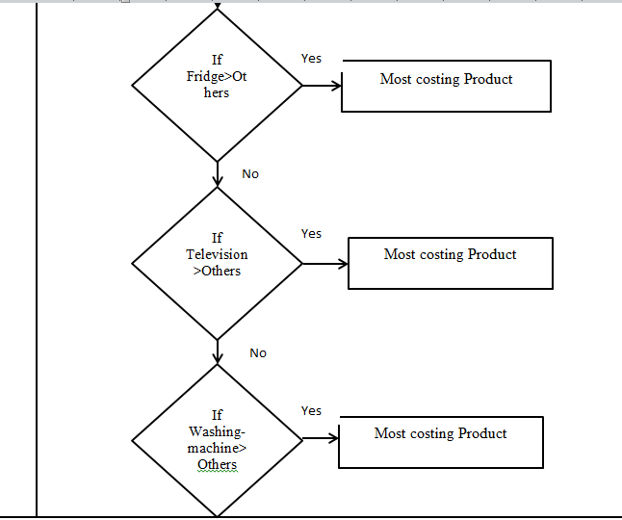

Slide 5
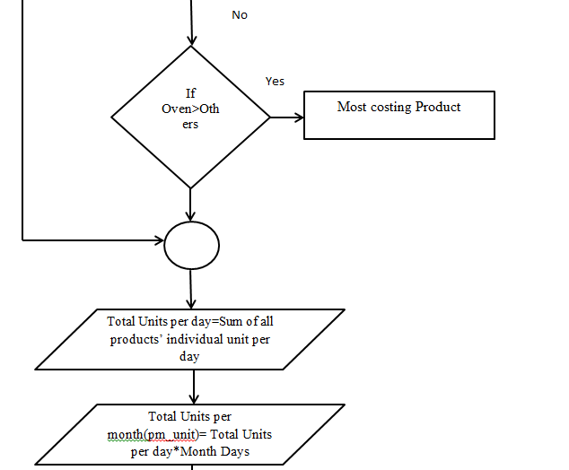
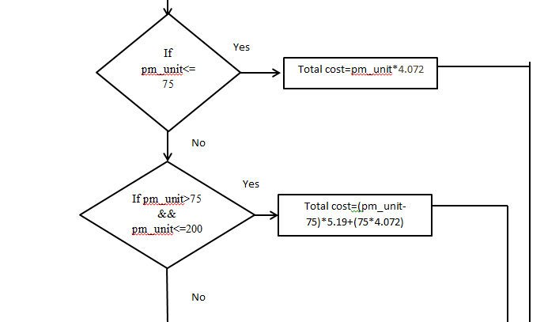

Slide 6
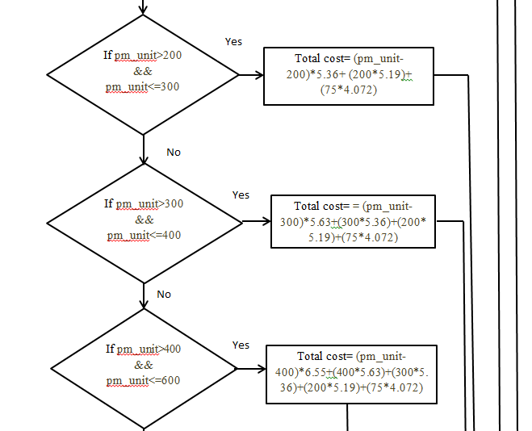
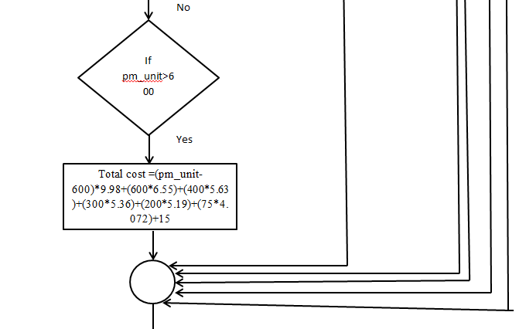

Slide 7
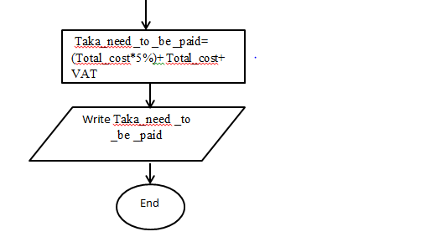
Source Code: #include<stdio.h>
#include<string.h>
float h,m;
float spti(float h,float m);
struct e_billcal
{
char product[20];
float h,m,whole_time;

Slide 8
double p_kwh;
double t_kwh;
};
int main()
{
int i,j=0,n,m_n,d,y,day,p_tk;
float s=0.00,x=0.00,pm_unit,total_cost,pay;
char m[10];
printf("Number of products in your house:");
scanf("%d",&n);
printf("Current date:");
scanf("%d%d%d",&day,&m_n,&y);
struct e_billcal e_p[n];

Slide 9
for(i=0;i<n;i++)
{
scanf("%s",e_p[i].product);
scanf("%f",&e_p[i].h);
scanf("%f",&e_p[i].m);
scanf("%lf",&e_p[i].p_kwh);
}
printf("\n\nProducts' Name\t Running Time\t\tTaka Per Kwh\t\tUnit per Product");
for(i=0;i<n;i++)
{
printf("\n%s",e_p[i].product);
e_p[i].whole_time=spti(e_p[i].h,e_p[i].m);

Slide 10
printf("\t\t\t\t %2.2f",e_p[i].whole_time);
printf("\t\t\t %lf",e_p[i].p_kwh);
e_p[i].t_kwh=e_p[i].whole_time*e_p[i].p_kwh;
printf("\t\t\t %lf",e_p[i].t_kwh);
s+=e_p[i].t_kwh;
}
for(i=0;i<n;i++)
{
if(x<e_p[i].t_kwh)
{
x=e_p[i].t_kwh;
j=i;
}

Slide 11
}
printf("\n\n\nTotal spent in a day=%.2lf",s);
printf("\n\nMost costing Product=%s",e_p[j].product);
if(m_n==12)
{
m_n=0;
y=y+1;
}
switch(m_n+1)
{
case 1:
case 3:
case 5:

Slide 12
case 7:
case 8:
case 10:
case 12:
d=31;
break;
case 4:
case 6:
case 9:
case 11:
d=30;
break;
}

Slide 13
if(m_n+1==2)
{
if(y%4==0)
d=29;
else if(y%400==0)
d=29;
else if(y%100!=0)
d=28;
else
d=28;
}
pm_unit=s*d;
printf("\n\nTotal Unit per month=%.2f",pm_unit);

Slide 14
if(pm_unit<=75)
{
total_cost=(pm_unit*4.072);
}
else if(pm_unit>75 && pm_unit<=200)
{
total_cost=(pm_unit-75)*5.19+(75*4.072);
}
else if(pm_unit>200 && pm_unit<=300)
{
total_cost=(pm_unit-200)*5.36+(200*5.19)+(75*4.072);
}

Slide 15
else if(pm_unit>300 && pm_unit<=400)
{
total_cost=(pm_unit-300)*5.63+(300*5.36)+(200*5.19)+(75*4.072);
}
else if(pm_unit>400 && pm_unit<=600)
{
total_cost=(pm_unit-400)*6.55+(400*5.63)+(300*5.36)+(200*5.19)+(75*4.072);
}
else if(pm_unit>600)
{

Slide 16
total_cost=(pm_unit-600)*9.98+(600*6.55)+(400*5.63)+(300*5.36)+(200*5.19)+(75*4.072)+15;
}
printf("\n\nTotal Cost=%.3lf",total_cost);
pay=(total_cost*0.05)+total_cost;
p_tk=ceil(pay)+30;/*vat-charge=30//=*/
printf("\n\nTaka need to be paid=%d",p_tk);
return (0);
}
float spti(float h,float m)
{
h=h+(m/60);
return (h);
}

Slide 17
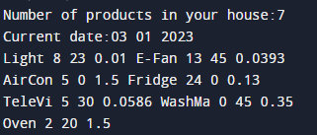
INPUT:

Slide 18
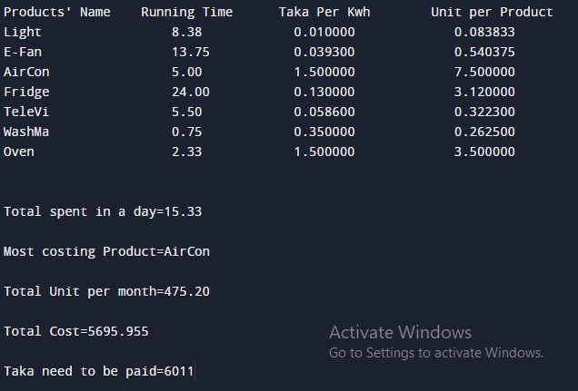
OUTPUT:

Slide 19
Conclusion:
This project can help people to forecast their electricity bills for the coming months to get cautioned of using over costing products or providing the basis for making decisions in power system planning and operation. Thus they can utilize the product in a cost effective way. As per this report, Air-Conditioner should be used less to maintain the cost.

Slide 20
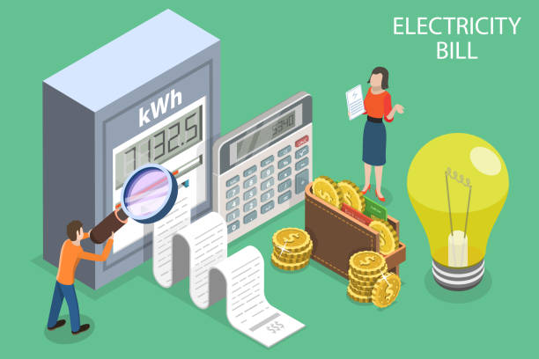
THANK YOU

